Slide 1


Slide 2
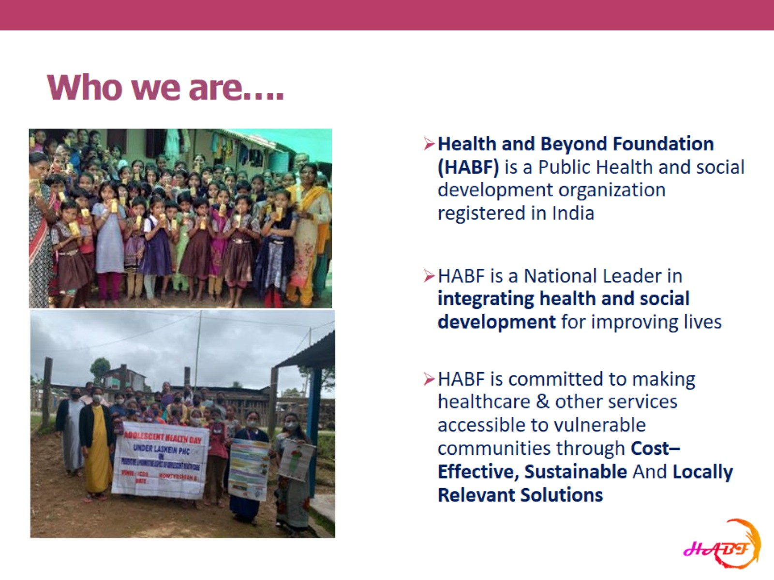
Who we are….

Slide 3
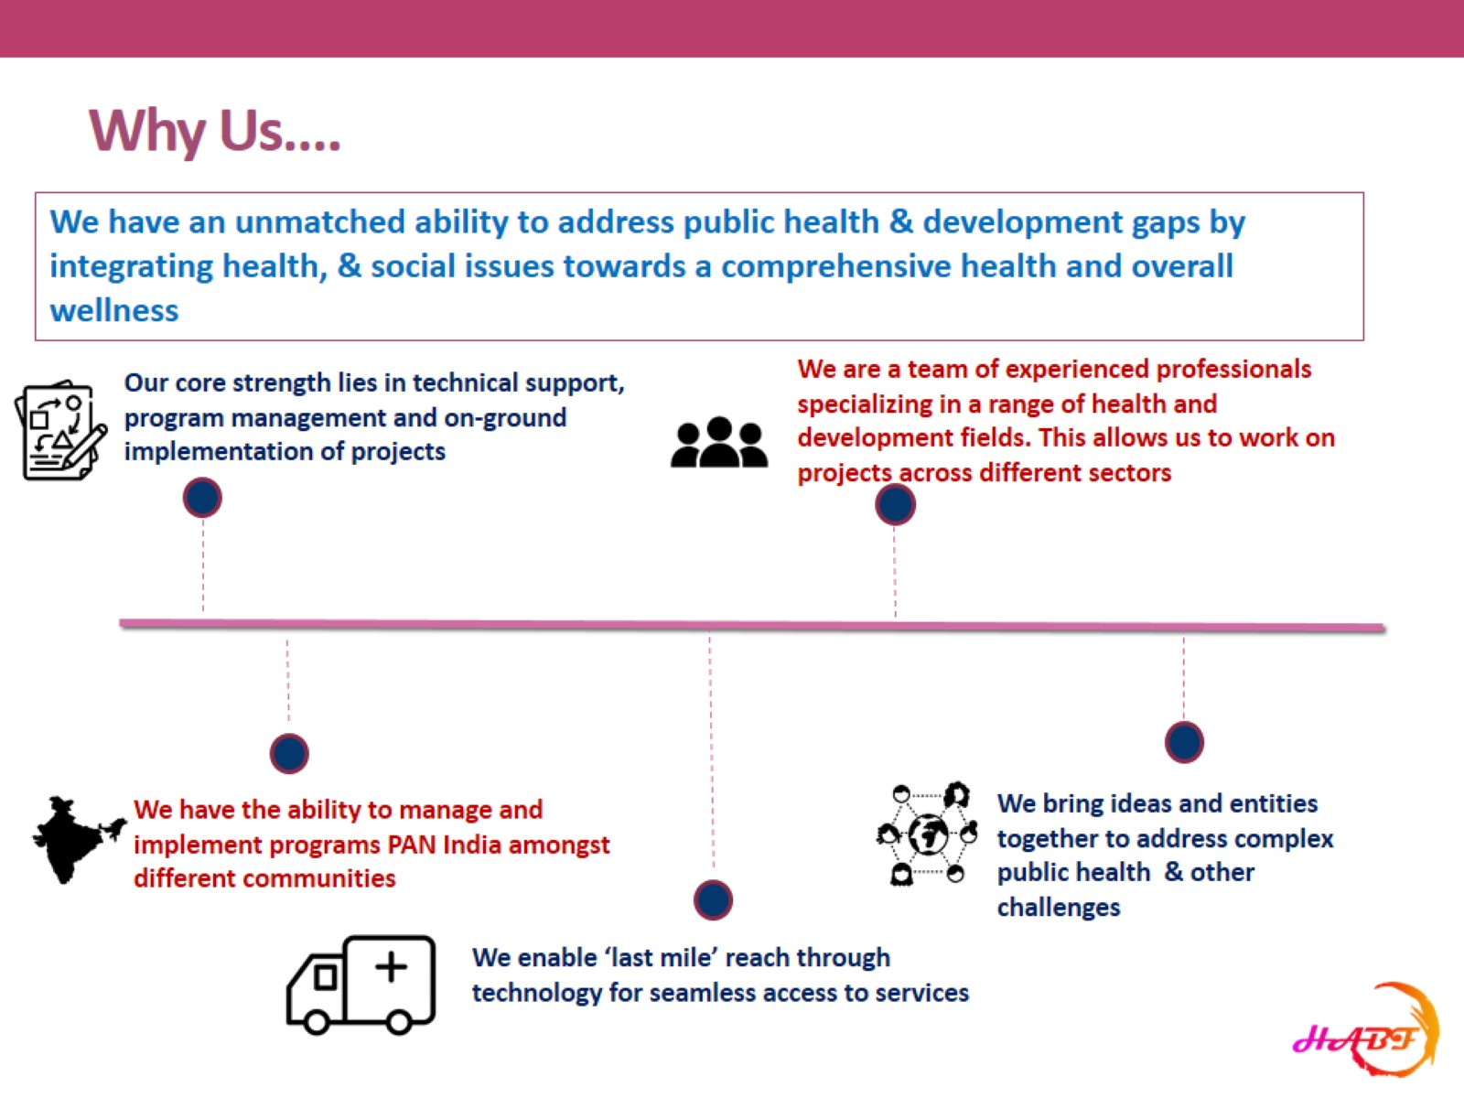
Why Us….

Slide 4
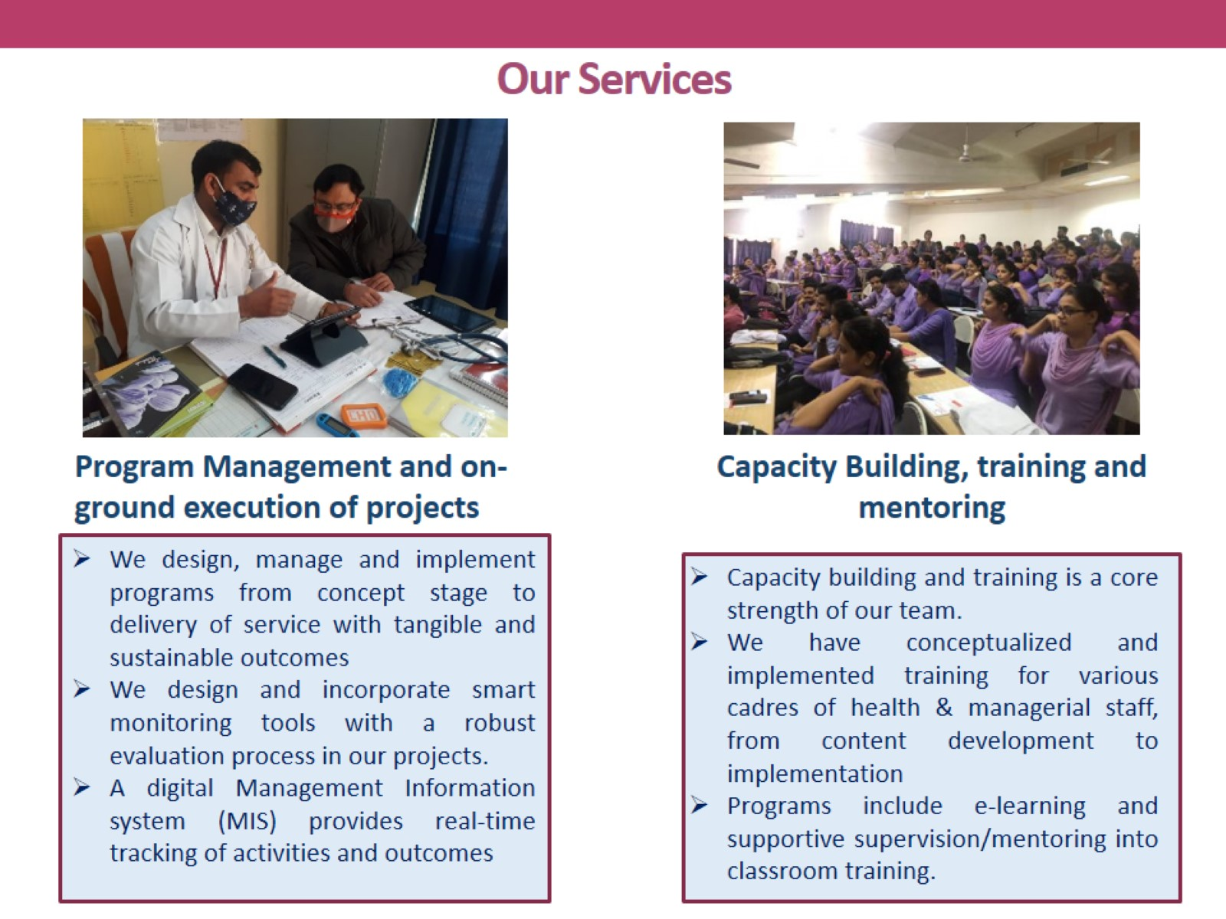
Our Services

Slide 5
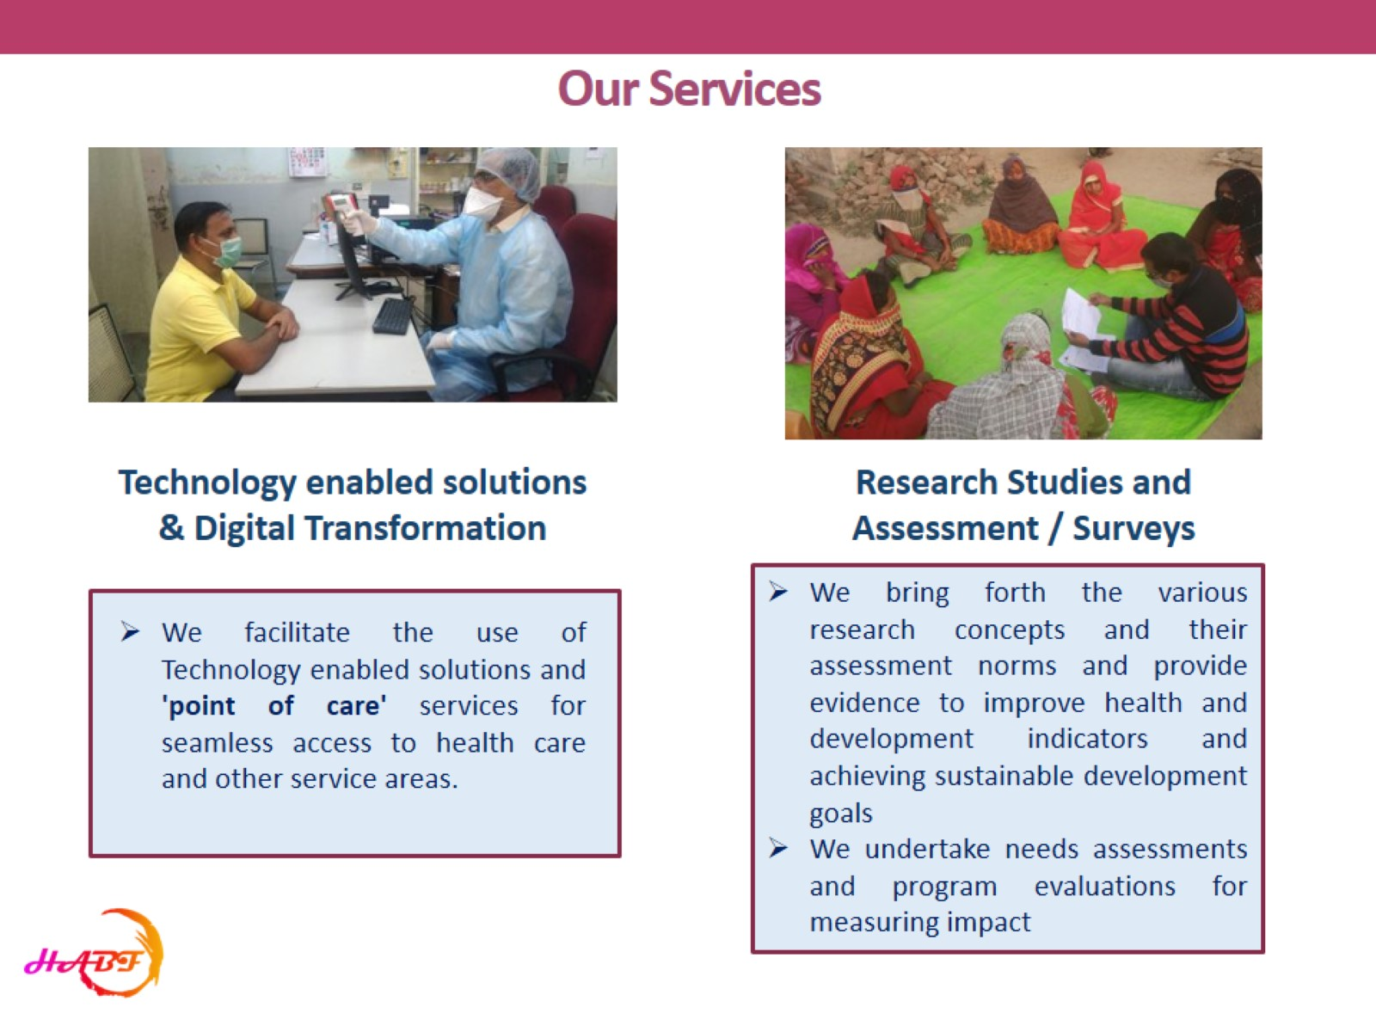
Our Services

Slide 6
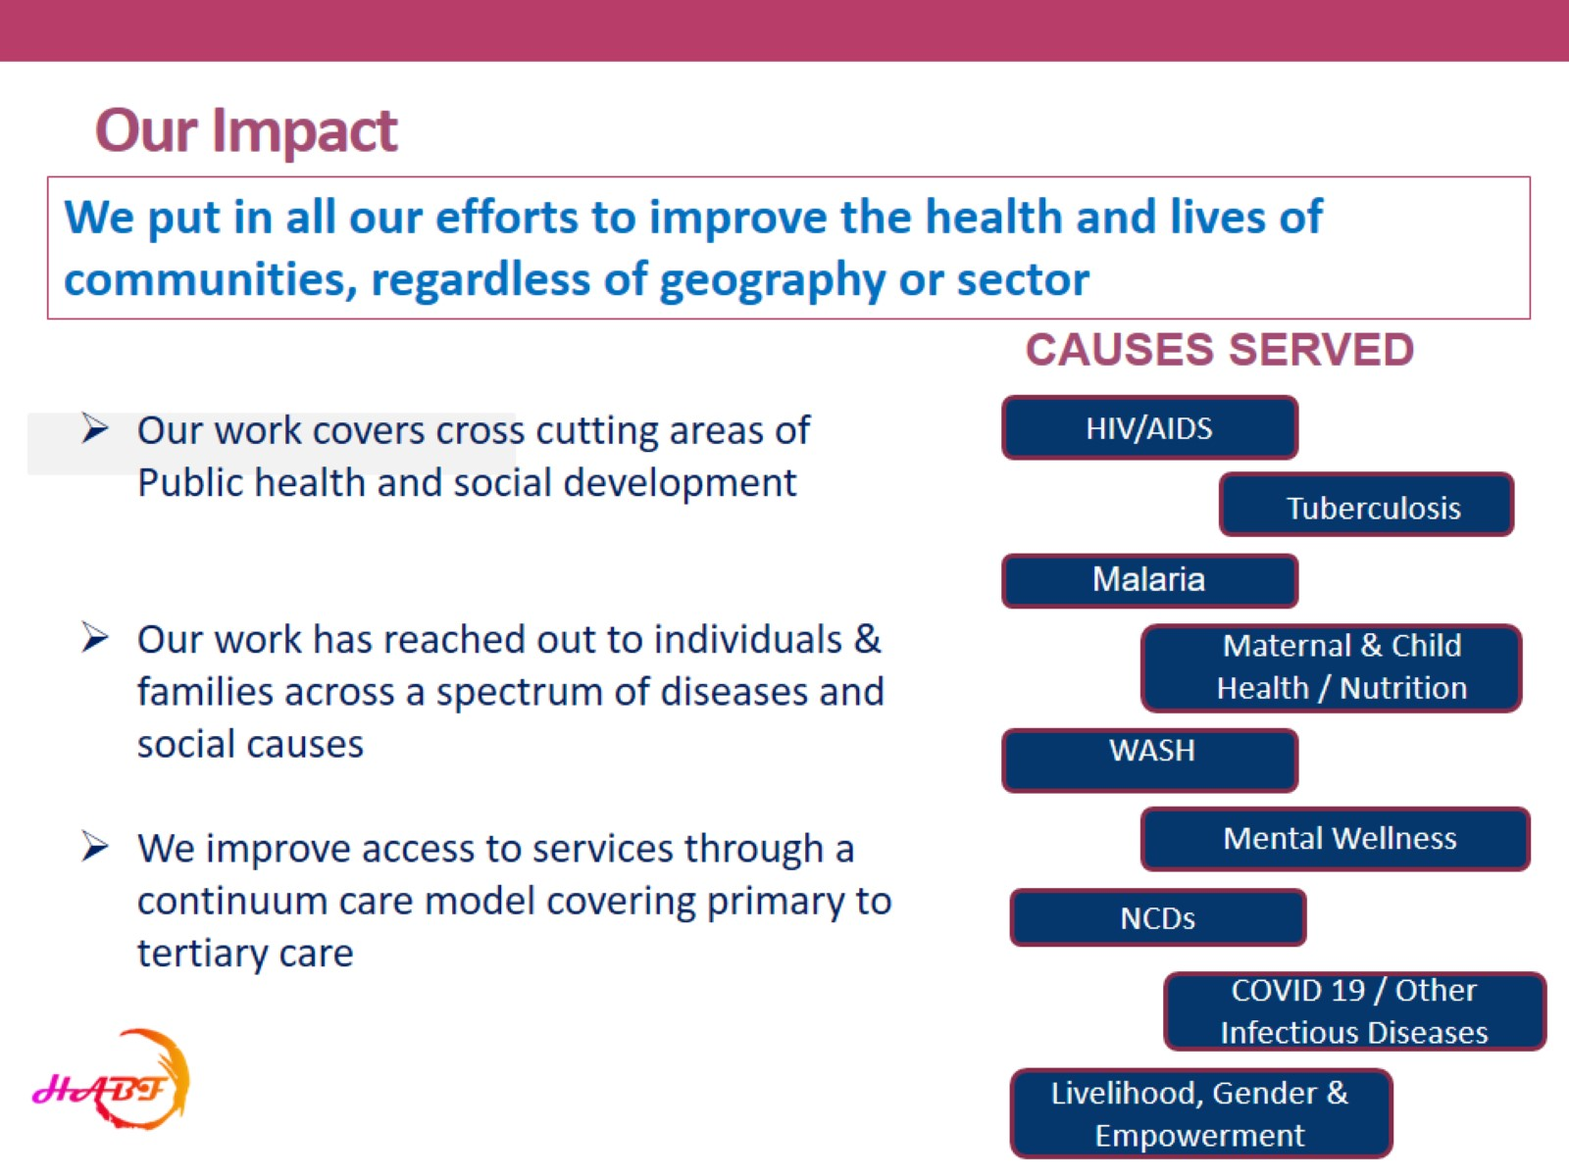
Our Impact

Slide 7
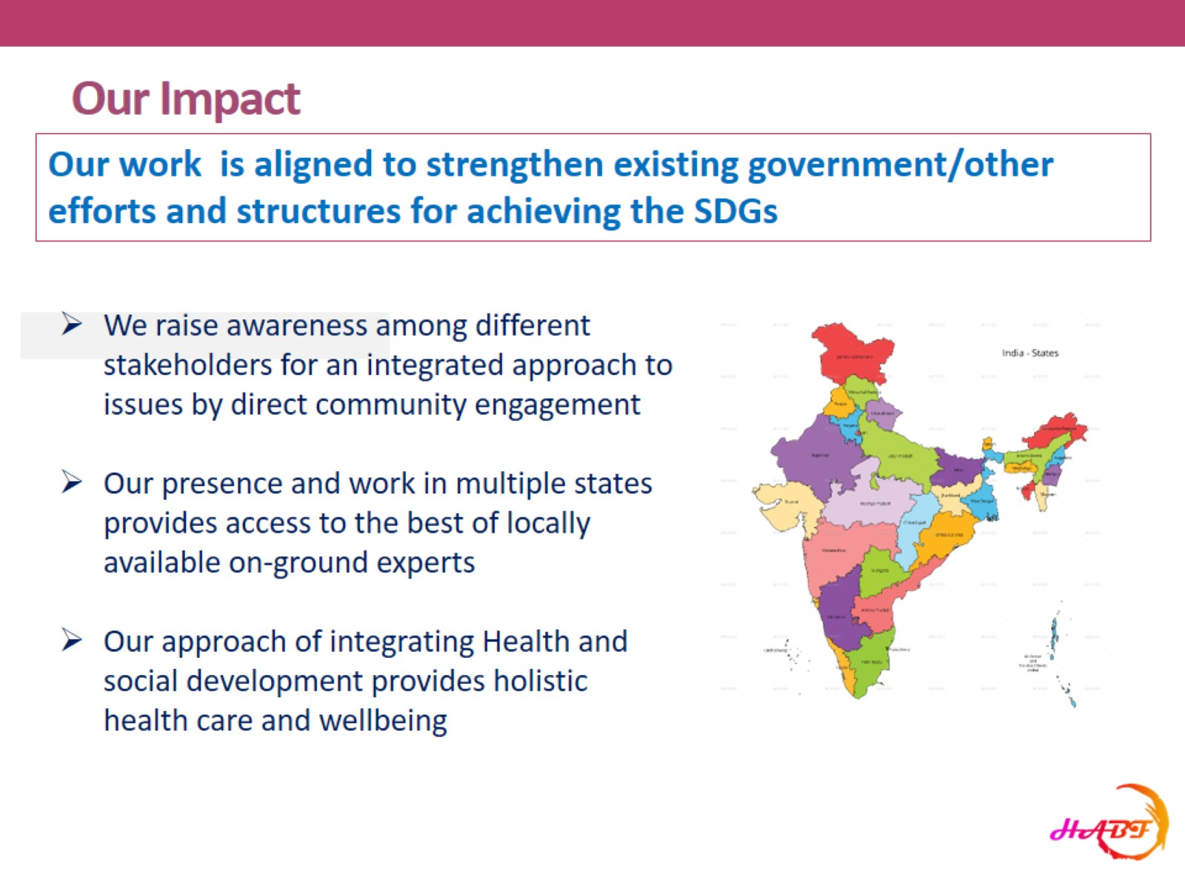
Our Impact

Slide 8
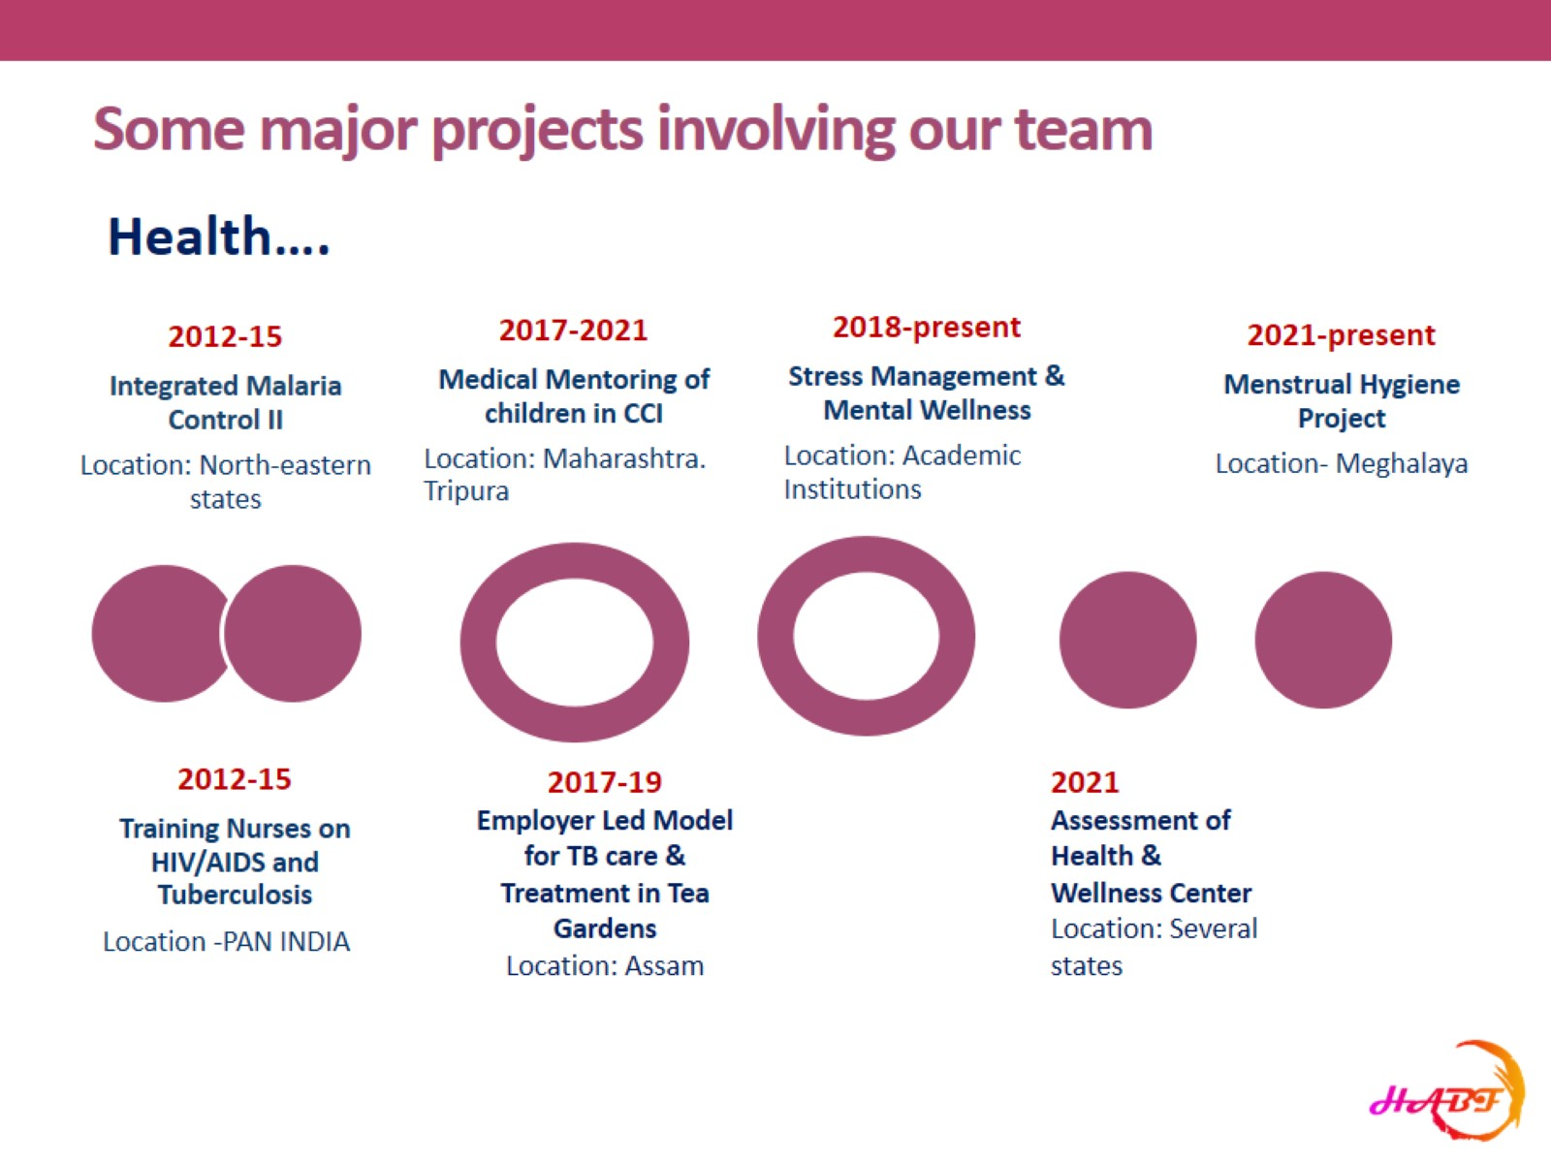
Some major projects involving our team

Slide 9
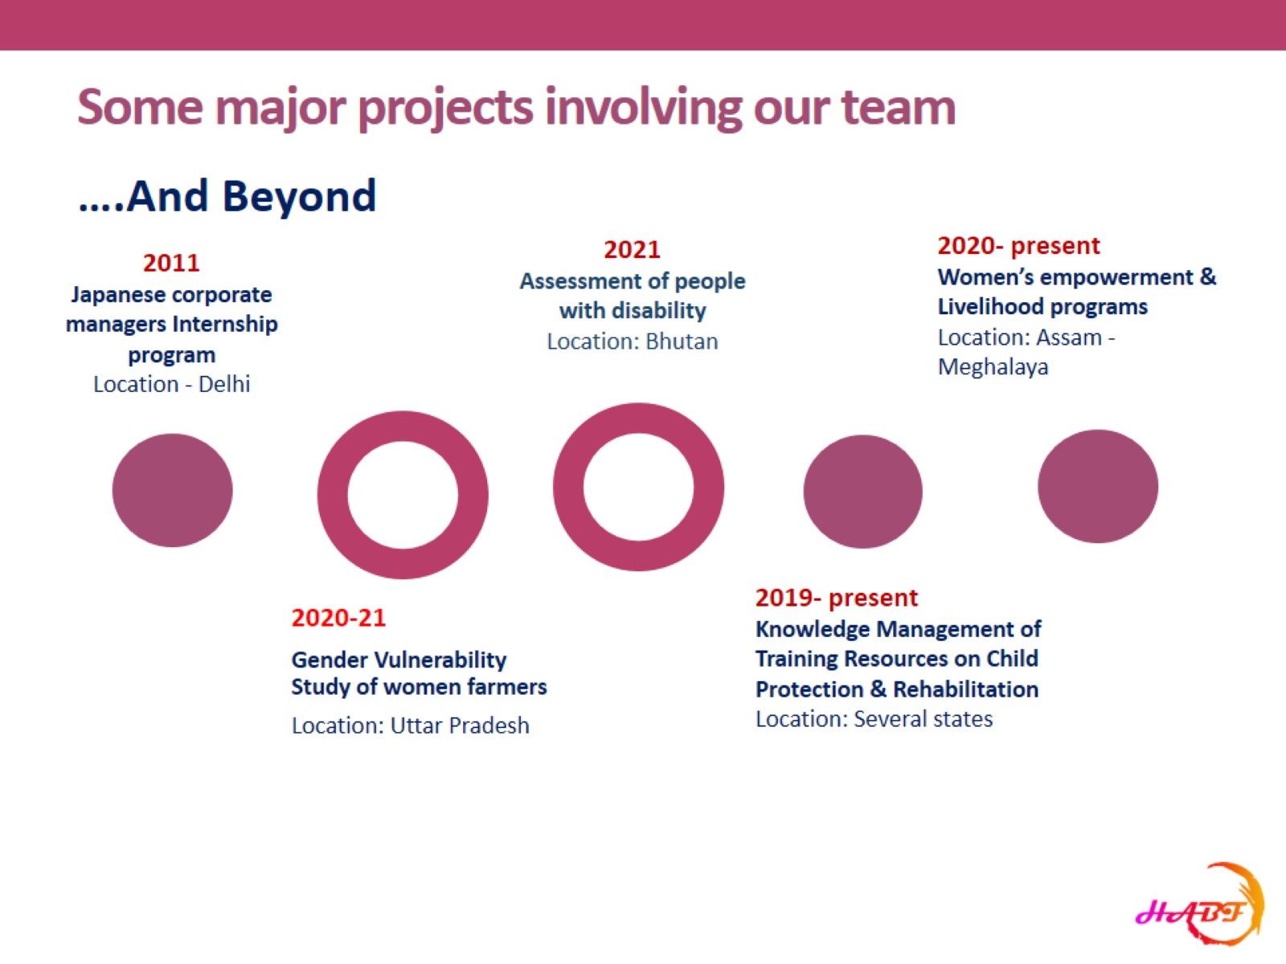
Some major projects involving our team

Slide 10
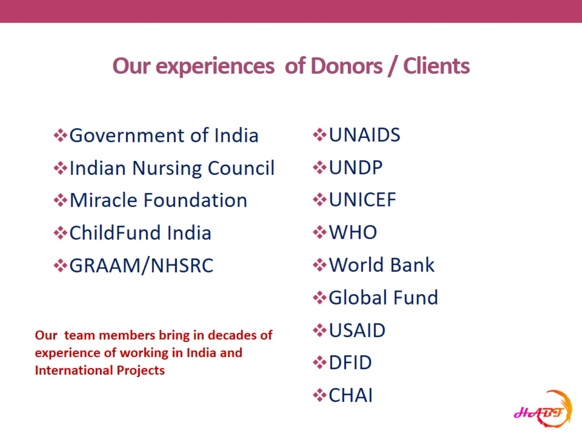
Our experiences of Donors / Clients

Slide 11

Our Multidisciplinary Team

Slide 12
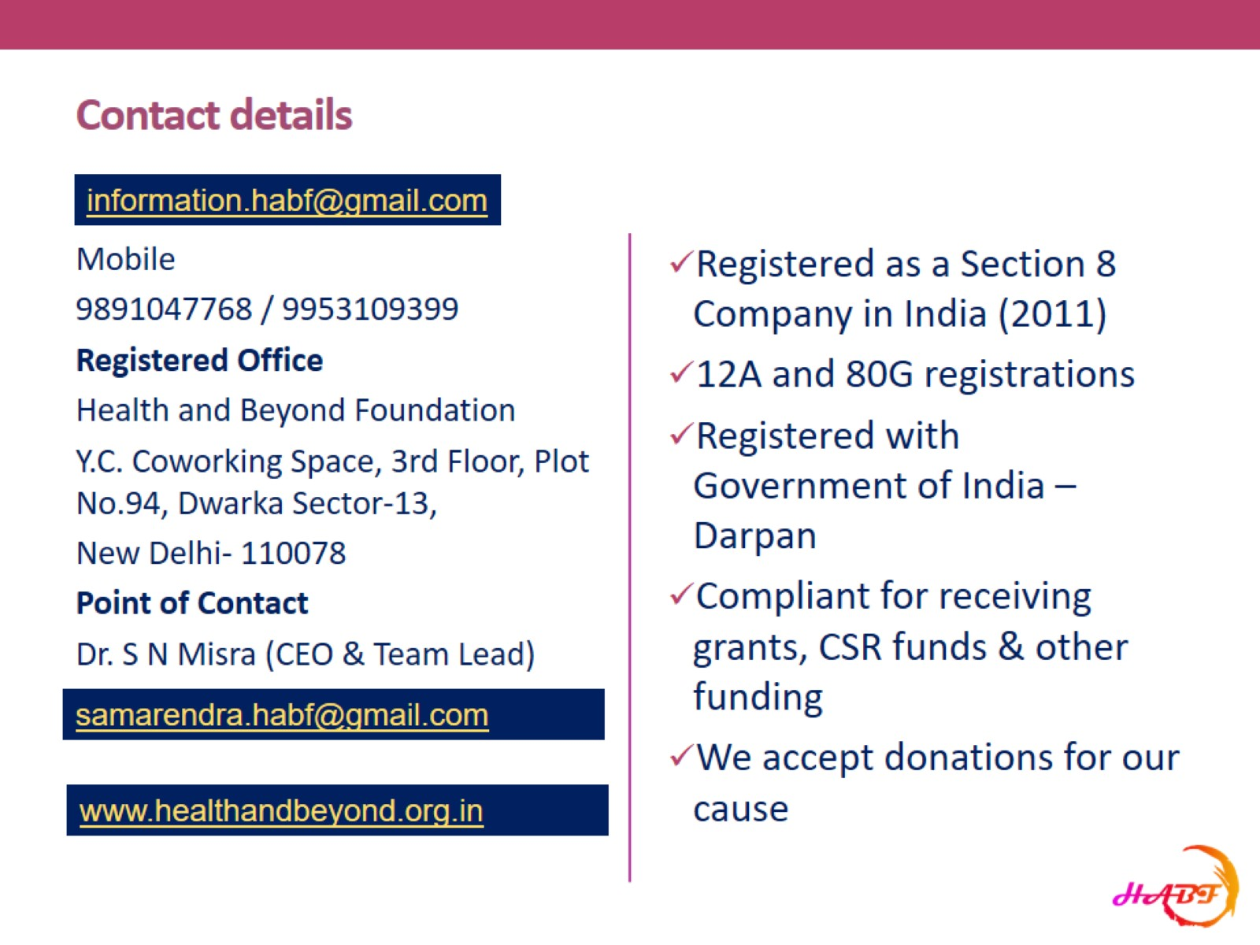
Contact details

